Slide 1


ICIC Bank Management System
-Ashish
© All rights reserved by Fireblaze Technologies Pvt. Ltd.

Slide 2

Problem Statement
  The objective of this project is to design and implement a comprehensive database system for ICIC Bank's customer management, with a focus on enhancing customer experience, improving operational efficiency, and ensuring data security.
© All rights reserved by Fireblaze Technologies Pvt. Ltd.

Slide 3


About the Data
Bank Details: Branch_code, Address, Department_id, Branch_name, State
Employees: Employee_id, First_name, Department_id, Manager_id, Job_id, Email, Hire_Date, Phone_no, Salary
Customer: Account_No, First_Name, City, Branch_code, Employee_id, Phone_no, ATM_NO, Exp_date, Pin_No
© All rights reserved by Fireblaze Technologies Pvt. Ltd.

Slide 4
About the Data
Department: Department_id, Department_name, Manager_id, Employee_id, Account_no, Opening_Date
Job_Details: Job_id, Department_id, Branch_code
Account_Type: Account_no, Type_Account, Manager_id, Department_name, Opening_Date
© All rights reserved by Fireblaze Technologies Pvt. Ltd.

Slide 5
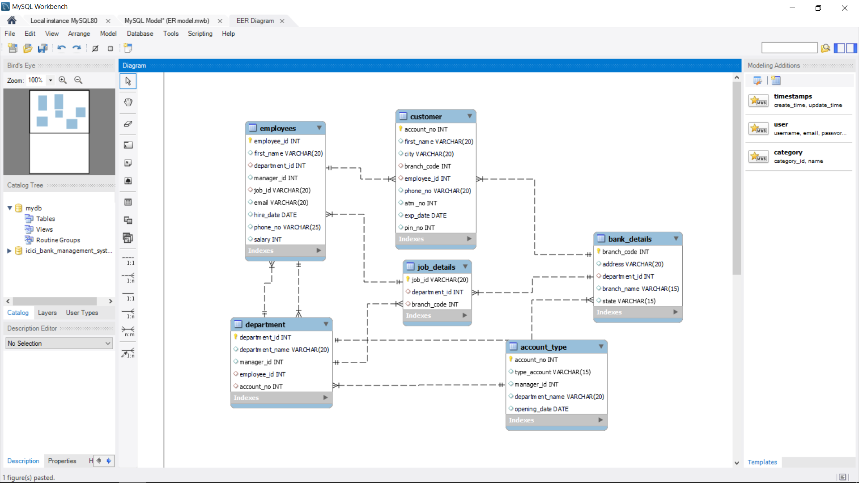
Entity Relation(ER) Diagram
© All rights reserved by Fireblaze Technologies Pvt. Ltd.

Slide 6

Proposed Solution
Centralized Database: Create a single system to store all customer information for easy management.
User-Friendly Interface: Design simple screens for bank staff to quickly find and update customer data.
Security Measures: Implement locks and security features to protect customer details from unauthorized access.
Analytics Tools: Integrate tools to analyse customer behaviour, enabling personalized services and improving overall service quality.
Centralized Database: Create a single system to store all customer information for easy management.
User-Friendly Interface: Design simple screens for bank staff to quickly find and update customer data.
Security Measures: Implement locks and security features to protect customer details from unauthorized access.
Analytics Tools: Integrate tools to analyse customer behaviour, enabling personalized services and improving overall service quality.
© All rights reserved by Fireblaze Technologies Pvt. Ltd.

Slide 7
Conclusion
  By successfully implementing the a customer management database system, ICIC Bank wants to make its operations smoother, offer better service to customers, and stay ahead in the banking industry.
© All rights reserved by Fireblaze Technologies Pvt. Ltd.

Slide 8

Future Scope
Enhanced Features: Think about adding things like mobile banking and digital wallets to make customers even happier.
Scalability: Make sure the system can handle more customers and transactions without slowing down as the bank grows.
Data Analysis: Use tools to figure out what customers like and want, so we can give them better service and offers.
Integration: Connect the database with other systems to make everything run smoother and work better overall.
© All rights reserved by Fireblaze Technologies Pvt. Ltd.

Slide 9

Future Scope
© All rights reserved by Fireblaze Technologies Pvt. Ltd.

